Slide 1

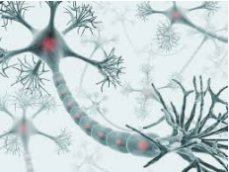
Multi Layer Neural Network
BackPropagation Algorithm
Version 2023
Abdelwahab Naji - Enseignant chercheur
Abdelwahab.naji@gmail.com
Laboratoire Signaux, Systèmes Distribués et Intelligence Artificielle (SSDIA)
ENSET de Mohammedia, Université Hassan II de Casablanca
https://www.youtube.com/c/AbdelwahabNaji

Slide 2
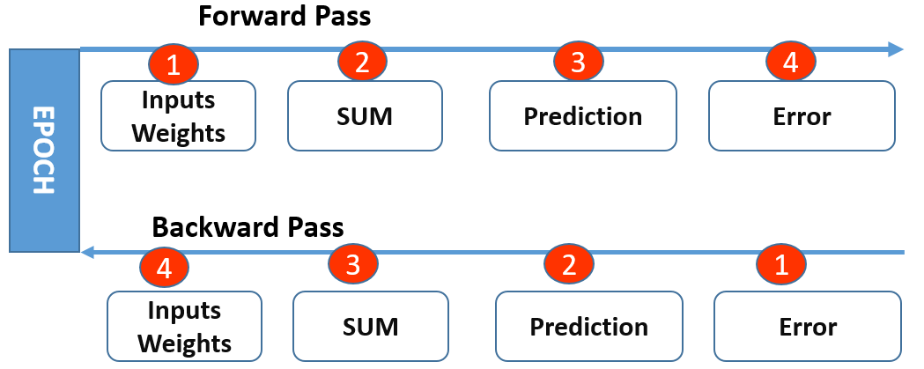

Backpropagation Algorithm
Après chaque passage en avant (Forward pass) à travers un réseau, la rétropropagation effectue un passage en arrière (Backward pass) tout en ajustant les paramètres du modèle (poids et biais).
L'algorithme est utilisé pour entraîner efficacement un réseau de neurones à l’aide d’une méthode appelée chain rule
chain rule
y = f(u) et u = g(x)
Forward pass: pour la prédiction
Backward pass: pour la correction

Slide 3
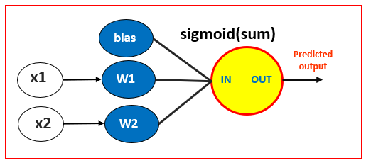

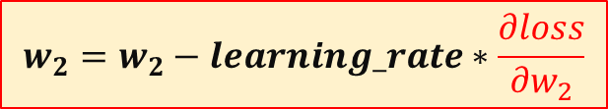

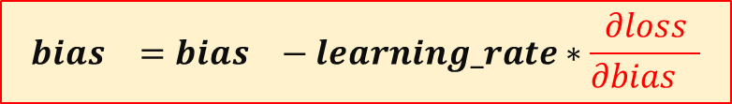

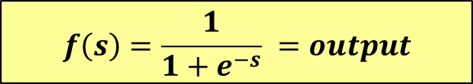
Algorithme
1
Initialize weights
Initialize learning rate
De 1 à n_epochs faire
$$sum=\sum_{i=0}^{n}{W_{i}∗X_{i}}$$
2
3
Activation function → output
$$f\left(s\right)=\frac{1}{1+e^{−s}} =output$$
De 1 à n_epochs faire
Forward pass
Backward pass
4
error= desired-predicted
$$Loss=\frac{1}{2}{\left(desired−predicted\right)}^{2}$$
5
Weights update
$$w_{1}=w_{1}−learning_rate∗\frac{∂loss}{{∂w}_{1}}$$
$$w_{2}=w_{2}−learning_rate∗\frac{∂loss}{{∂w}_{2}}$$
$${bias}_{}={bias}_{}−learning_rate∗\frac{∂loss}{{∂bias}_{}}$$

Slide 4
Exemple
X1 | X2 | output
0.1 | 0.3 | 0.03
…
bias
sigmoid(sum)
Predicted
output
x1
W1
IN
OUT
learning_rate=0.01
x2
W2
Initialiser les poids de manière aléatoire
Mettre à jour les poids en appliquant l’algorithme de backpropabation pour minimiser la fonction Loss
Tourner l’algorithme en deux itérations

Slide 5














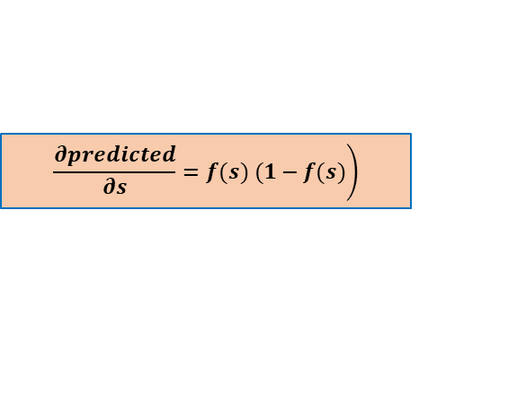


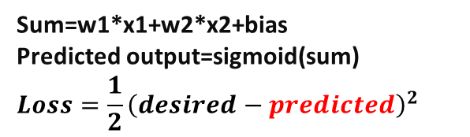
X1 | X2 | output
0.1 | 0.3 | 0.03
…
bias
Activation:
sigmoid(sum)
learning_rate=0.01
1.83
Forward pass
w1
Predicted
output
X1
0.1
0.5
sum
OUT
Sum=w1*x1+w2*x2+bias
Predicted output=sigmoid(sum)
$$Loss=\frac{1}{2}{\left(desired−predicted\right)}^{2}$$
w2
X2
0.3
0.2
Backward pass
$$\frac{∂Loss}{∂predicted}=predicted−desired$$
$$w_{1}=w_{1}−learning_rate∗\frac{∂loss}{{∂w}_{1}}$$
$\frac{∂Loss}{∂w1}$=
$$\frac{∂Loss}{∂predicted}$$
$$\frac{∂predicted}{∂s}$$
$$\frac{∂s}{∂w1}$$
*
*
$$\left.\frac{∂predicted}{∂s}=f(s) (1−f(s)\right)$$
$$w_{2}=w_{2}−learning_rate∗\frac{∂loss}{{∂w}_{2}}$$
$\frac{∂Loss}{∂w2}$=
$$\frac{∂Loss}{∂predicted}$$
$$\frac{∂predicted}{∂s}$$
$$\frac{∂s}{∂w2}$$
$$\frac{∂s}{∂w1}=x1$$
*
*
$${bias}_{}={bias}_{}−learning_rate∗\frac{∂loss}{{∂bias}_{}}$$
$$\frac{∂s}{∂w2}=x2$$
$\frac{∂Loss}{∂bias}$=
$$\frac{∂Loss}{∂predicted}$$
$$\frac{∂predicted}{∂s}$$
*
$$\frac{∂s}{∂bias}$$
*
$$\frac{∂s}{∂bias}=1$$

Slide 6
Backpropagation – Algorithm (version1: utiliser des matrices)
Epoch 10000: ------------------------------------
sum:-3.2627453450687973
prediction: 0.036871592334909074
Loss-quadr: 2.360939060859058E-5
0,027 -1,219 -2,900
-------------------------------------------------
backpropagation

Slide 7
Update weights and bias for Multilayer NN
Forward pass
bias1
0.4
bias3
0.25
0.1
0.5
sum1
out1
w5
w1
0.6
0.35
w2
sum3
out3
w3
-0.7
w6
0.03
0.2
0.8
-0.45
sum2
out2
w4
bias2
0.9
Backward pass

Slide 8
Update weights and bias for Multilayer NN
Forward pass
bias1
0.4
bias3
0.25
0.1
0.5
sum1
out1
w5
w1
0.6
0.35
w2
sum3
out3
w3
-0.7
w6
0.03
0.2
0.8
-0.45
sum2
out2
w4
bias2
0.9
Backward pass

Slide 9
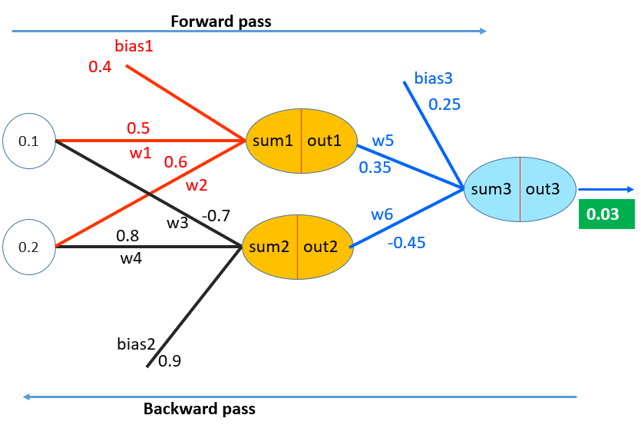













Comment?
$$w_{1}=w_{1}−learning_rate∗\frac{∂loss}{{∂w}_{1}}$$
$$w_{2}=w_{2}−learning_rate∗\frac{∂loss}{{∂w}_{2}}$$
$$w_{3}=w_{3}−learning_rate∗\frac{∂loss}{{∂w}_{3}}$$
$$w_{4}=w_{4}−learning_rate∗\frac{∂loss}{{∂w}_{4}}$$
$$w_{5}=w_{5}−learning_rate∗\frac{∂loss}{{∂w}_{5}}$$
$$w_{hidden}=w_{hidden}−learning_rate∗\frac{∂loss}{{∂w}_{hidden}}$$
$$w_{6}=w_{6}−learning_rate∗\frac{∂loss}{{∂w}_{6}}$$
$${bias}_{1}={bias}_{1}−learning_rate∗\frac{∂loss}{{∂bias}_{1}}$$
$$w_{out}=w_{out}−learning_rate∗\frac{∂loss}{{∂w}_{out}}$$
$${bias}_{2}={bias}_{2}−learning_rate∗\frac{∂loss}{{∂bias}_{2}}$$
$${bias}_{3}={bias}_{3}−learning_rate∗\frac{∂loss}{{∂bias}_{3}}$$
$${bias}_{hidden}={bias}_{hidden}−learning_rate∗\frac{∂loss}{{∂bias}_{hidden}}$$
$${bias}_{out}={bias}_{out}−learning_rate∗\frac{∂loss}{{∂w}_{bias}}$$

Slide 10
1) Update hidden layer weights and bias

Slide 11

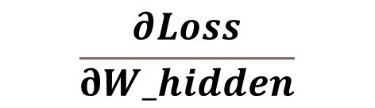


Update hidden layer weights and bias
$$\frac{∂Loss}{∂W_hidden}$$
$$w_{hidden}=w_{hidden}−learning_rate∗\frac{∂loss}{{∂w}_{hidden}}$$
Calculer
$$\frac{∂Loss}{∂bias_hidden}$$
$${bias}_{hidden}={bias}_{hidden}−learning_rate∗\frac{∂loss}{{∂bias}_{hidden}}$$
Calculer

Slide 12
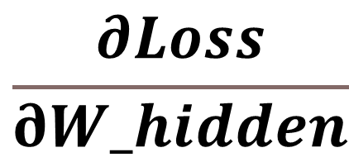
Update hidden layer weights
$$\frac{∂Loss}{∂W_hidden}$$

Slide 13


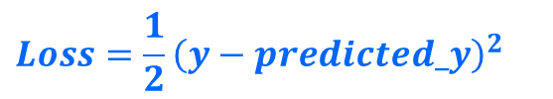
Backpropagation – MultiLayer NN
Utilisation de chain rule pour trouver $\frac{∂Loss}{∂W_hidden}$
out3=Predicted_y
$$Loss=\frac{1}{2}{\left(y−predicted_y\right)}^{2}$$
$$Loss=\frac{1}{2}{\left(y−predicted_y\right)}^{2}$$
dloss_depredicted=(predicted_y-y)
predicted_y =sigmoid(sum3)
dpredecited_dsum3= sigmoid_derivative(predicted_y)
sum3 =w5*out1+w6*out2+bias3
dsum3_dout1= w5
out1 =sigmoid(sum1)
d_out1_dsum1=sigmoid_derivative(out1)
sum1 =w1*x1+w2*x2+bias1
d_sum1_dw1 =x1
dloss_dw1=(predicted_y-y)* sigmoid_derivative(predicted_y)* w5* sigmoid_derivative(out1)* x1

Slide 14

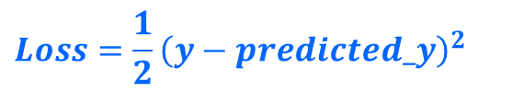
Backpropagation – MultiLayer NN
Utilisation de chaine rule pour trouver $\frac{∂Loss}{∂W_hidden}$
$$Loss=\frac{1}{2}{\left(y−predicted_y\right)}^{2}$$
dloss_depredicted=(predicted_y-y)
predicted_y =sigmoid(sum3)
dpredecited_dsum3= sigmoid_derivative(predicted_y)
sum3 =w5*out1+w6*out2+bias3
dsum3_dout1= w5
out1 =sigmoid(sum1)
d_out1_dsum1=sigmoid_derivative(out1)
sum1 =w1*x1+w2*x2+bias1
d_sum1_dw2 =x2
dloss_dw2=(predicted_y-y)* sigmoid_derivative(predicted_y)* w5* sigmoid_derivative(out1)* x2

Slide 15


Backpropagation – MultiLayer NN
Utilisation de chaine rule pour trouver $\frac{∂Loss}{∂W_hidden}$
$$Loss=\frac{1}{2}{\left(y−predicted_y\right)}^{2}$$
dloss_depredicted=(predicted_y-y)
predicted_y =sigmoid(sum3)
dpredecited_dsum3= sigmoid_derivative(predicted_y)
sum3 =w5*out1+w6*out2+bias3
dsum3_dout2= w6
out2 =sigmoid(sum2)
d_out2_dsum2=sigmoid_derivative(out2)
sum2 =w3*x1+w4*x2+bias2
d_sum2_dw3 =x1
dloss_dw3=(predicted_y-y)* sigmoid_derivative(predicted_y)* w6* sigmoid_derivative(out2)* x1

Slide 16

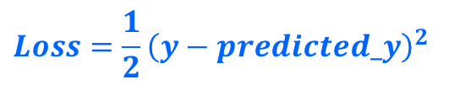
Backpropagation – MultiLayer NN
Utilisation de chaine rule pour trouver $\frac{∂Loss}{∂W_hidden}$
$$Loss=\frac{1}{2}{\left(y−predicted_y\right)}^{2}$$
dloss_depredicted=(predicted_y-y)
predicted_y =sigmoid(sum3)
dpredecited_dsum3= sigmoid_derivative(predicted_y)
sum3 =w5*out1+w6*out2+bias3
dsum3_dout2= w6
out2 =sigmoid(sum2)
d_out2_dsum2=sigmoid_derivative(out2)
sum2 =w3*x1+w4*x2+bias2
d_sum2_dw4 =x2
dloss_dw4=(predicted_y-y)* sigmoid_derivative(predicted_y)* w6* sigmoid_derivative(out2)* x2

Slide 17

Update hidden layer weights
$$\frac{∂Loss}{∂W_hidden}$$
dloss_dw1=(predicted_y-y)* sigmoid_derivative(predicted_y)* w5* sigmoid_derivative(out1)* x1
dloss_dw2=(predicted_y-y)* sigmoid_derivative(predicted_y)* w5* sigmoid_derivative(out1)* x2
dloss_dw3=(predicted_y-y)* sigmoid_derivative(predicted_y)* w6* sigmoid_derivative(out2)* x1
dloss_dw4=(predicted_y-y)* sigmoid_derivative(predicted_y)* w6* sigmoid_derivative(out2)* x2
dloss_dw=(predicted_y-y)* sigmoid_derivative(predicted_y)* output_W* sigmoid_derivative(h_out)* X
Code python
dloss_dw_h= X.T.dot((predicted_y-y)* sigmoid_derivative(predicted_y).dot(output_weights.T)*sigmoid_derivative(hidden_layer_out))

Slide 18
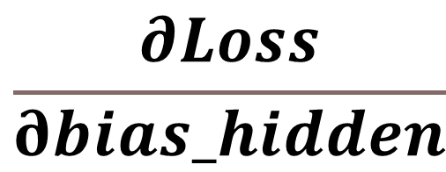
Update hidden layer bias
$$\frac{∂Loss}{∂bias_hidden}$$

Slide 19

Backpropagation – MultiLayer NN
Utilisation de chaine rule pour trouver $\frac{∂Loss}{∂bias_hidden}$
$$Loss=\frac{1}{2}{\left(y−predicted_y\right)}^{2}$$
dloss_depredicted=(predicted_y-y)
predicted_y =sigmoid(sum3)
dpredecited_dsum3= sigmoid_derivative(predicted_y)
sum3 =w5*out1+w6*out2+bias3
dsum3_dout1= w5
out1 =sigmoid(sum1)
d_out1_dsum1=sigmoid_derivative(out1)
sum1 =w1*x1+w2*x2+bias1
d_sum1_bias1 =1
dloss_bias1=(predicted_y-y)* sigmoid_derivative(predicted_y)* w5* sigmoid_derivative(out1)* 1

Slide 20

Backpropagation – MultiLayer NN
Utilisation de chaine rule pour trouver $\frac{∂Loss}{∂bias_hidden}$
$$Loss=\frac{1}{2}{\left(y−predicted_y\right)}^{2}$$
dloss_depredicted=(predicted_y-y)
predicted_y =sigmoid(sum3)
dpredecited_dsum3= sigmoid_derivative(predicted_y)
sum3 =w5*out1+w6*out2+bias3
dsum3_dout2= w6
out2 =sigmoid(sum2)
d_out1_dsum2=sigmoid_derivative(out2)
sum2 =w3*x1+w4*x2+bias2
d_sum2_bias2 =1
dloss_bias2=(predicted_y-y)* sigmoid_derivative(predicted_y)* w6* sigmoid_derivative(out2)* 1

Slide 21

Update hidden layer bias
$$\frac{∂Loss}{∂bias_hidden}$$
dloss_bias1=(predicted_y-y)* sigmoid_derivative(predicted_y)* w5* sigmoid_derivative(out1)* 1
dloss_bias2=(predicted_y-y)* sigmoid_derivative(predicted_y)* w6* sigmoid_derivative(out2)* 1
dloss_bias_h=(predicted_y-y)* sigmoid_derivative(predicted_y)* output_W * sigmoid_derivative(h_out)
Code python
dloss_dbias_h=(predicted_y-y)* sigmoid_derivative(predicted_y).dot(output_weights.T)*sigmoid_derivative(hidden_layer_out)

Slide 22
2) Update output layer weights and bias

Slide 23
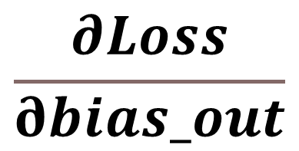
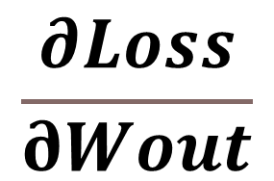


Update output layer weights and bias
$$\frac{∂Loss}{∂Wout}$$
Calculer
$$w_{out}=w_{out}−learning_rate∗\frac{∂loss}{{∂w}_{out}}$$
$$\frac{∂Loss}{∂bias_out}$$
Calculer
$${bias}_{out}={bias}_{out}−learning_rate∗\frac{∂loss}{{∂w}_{bias}}$$

Slide 24

Update output layer weights
$$\frac{∂Loss}{∂Wout}$$

Slide 25

Backpropagation – MultiLayer NN
Utilisation de chaine rule pour trouver $\frac{∂Loss}{∂Wout}$
$$Loss=\frac{1}{2}{\left(y−predicted_y\right)}^{2}$$
dloss_depredicted=(predicted_y-y)
predicted_y =sigmoid(sum3)
dpredecited_dsum3= sigmoid_derivative(predicted_y)
sum3 =w5*out1+w6*out2+bias3
d_sum3_dw5 =out1
dloss_dw5=(predicted_y-y)* sigmoid_derivative(predicted_y) * out1

Slide 26

Backpropagation – MultiLayer NN
Utilisation de chaine rule pour trouver $\frac{∂Loss}{∂Wout}$
$$Loss=\frac{1}{2}{\left(y−predicted_y\right)}^{2}$$
dloss_depredicted=(predicted_y-y)
predicted_y =sigmoid(sum3)
dpredecited_dsum3= sigmoid_derivative(predicted_y)
sum3 =w5*out1+w6*out2+bias3
d_sum3_dw6 =out2
dloss_dw6=(predicted_y-y)* sigmoid_derivative(predicted_y) * out2

Slide 27

$$\frac{∂Loss}{∂Wout}$$
dloss_dw5=(predicted_y-y)* sigmoid_derivative(predicted_y) * out1
dloss_dw6=(predicted_y-y)* sigmoid_derivative(predicted_y) * out2
dloss_dw_out=(predicted_y-y)* sigmoid_derivative(predicted_y) * h_out
Code python
dloss_dw_out=hidden_layer_out.T.dot((predicted_y-y)*sigmoid_derivative(predicted_y))

Slide 28
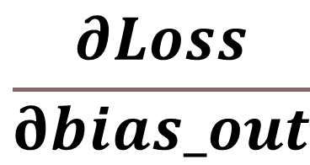
Update output layer bias
$$\frac{∂Loss}{∂bias_out}$$

Slide 29

Backpropagation – MultiLayer NN
Utilisation de chaine rule pour trouver $\frac{∂Loss}{∂Bias_out}$
$$Loss=\frac{1}{2}{\left(y−predicted_y\right)}^{2}$$
dloss_depredicted=(predicted_y-y)
predicted_y =sigmoid(sum3)
dpredecited_dsum3= sigmoid_derivative(predicted_y)
sum3 =w5*out1+w6*out2+bias3
d_sum3_dbias3 =1
dloss_bias3=(predicted_y-y)* sigmoid_derivative(predicted_y) * 1

Slide 30
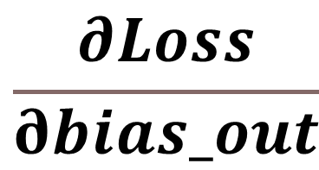
$$\frac{∂Loss}{∂bias_out}$$
dloss_bias3=(predicted_y-y)* sigmoid_derivative(predicted_y) * 1
dloss_dbias_out=(predicted_y-y)* sigmoid_derivative(predicted_y)
Code python
dloss_dbias_out = (predicted_y-y)*sigmoid_derivative(predicted_y)

Slide 31
#inputs
X = np.array([[0.1,0.2]])
y = np.array([[0.03]])
learning_rate= 0.1
#weights and bias initialization
hidden_weights = [[0.5,0.6],[-0.7,0.8]]
hidden_bias =[0.4,0.9]
output_weights = np.array([[0.35],[-0.45]])
output_bias = np.array([[0.25]])

Slide 32
#Learning process
#Forward Pass
hidden_layer_sum = np.dot(X,hidden_weights) + hidden_bias
hidden_layer_out = sigmoid(hidden_layer_sum)
output_layer_sum = np.dot(hidden_layer_out,output_weights) + output_bias
predicted_y = sigmoid(output_layer_sum)

Slide 33
#Learning process
#Backward pass
#hidden layer
dloss_dw_h= X.T.dot((predicted_y-y)* sigmoid_derivative(predicted_y).dot(output_weights.T)*sigmoid_derivative(hidden_layer_out))
dloss_dbias_h=(predicted_y-y)* sigmoid_derivative(predicted_y).dot(output_weights.T)*sigmoid_derivative(hidden_layer_out)
#output layer
dloss_dw_out=hidden_layer_out.T.dot((predicted_y-y)*sigmoid_derivative(predicted_y))
dloss_dbias_out=(predicted_y-y)*sigmoid_derivative(predicted_y)
dloss_dbias_h=(predicted_y-y)* sigmoid_derivative(predicted_y).dot(output_weights.T)*sigmoid_derivative(hidden_layer_out)
dloss_dbias_h=(predicted_y-y)* sigmoid_derivative(predicted_y).dot(output_weights.T)*sigmoid_derivative(hidden_layer_out)
dloss_dw_out=hidden_layer_out.T.dot((predicted_y-y)*sigmoid_derivative(predicted_y))
dloss_dbias_out = (predicted_y-y)*sigmoid_derivative(predicted_y)

Slide 34
#update
hidden_weights-=dloss_dw_h*learning_rate
hidden_bias-=dloss_dbias_h*learning_rate
hidden_bias=np.sum(hidden_bias,axis=0,keepdims=True)
output_weights-=dloss_dw_out*learning_rate
output_bias-=np.sum(dloss_dbias_out,axis=0,keepdims=True)*learning_rate

Slide 35
#print results
print("results------------------------------------")
print("updated hidden weights: ")
print(hidden_weights)
print("updated hidden biases: ")
print(hidden_bias)
print("updated output weights: ")
print(output_weights)
print("updated output biases: ")
print(output_bias)

